Slide 1
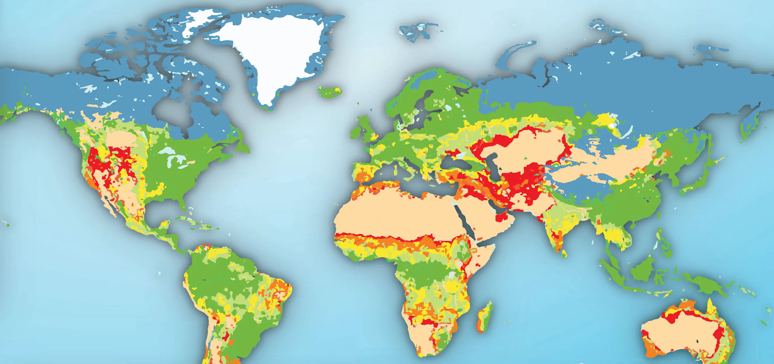



The Use of Geoinformation in (Anticipatory) Humanitarian Action
Karen Dall, Alec-Schulze Eckel und Melanie Eckle-Elze

Slide 2
Session 3 - Agenda
Time | Content
09:00 | Welcome Recap of self-study time Overview of today`s course
09:25 | Spatial Analyses Intro
10:00 | Coffee break
10:15 | Spatial and Non-spatial Analyses in QGIS Hands-on
11:15 | Coffee break
11:30 | Geoproccessing operations in QGIS Hands-on
12:15 | (Non-) Spatial Joins
12:30 | Self assignment start

Slide 3
Recap of self-study time/ results
Share your experiences:
What did you find easy / complicated?
What are potential use cases for you?
Any open questions?

Slide 4
Spatial Analyses

Slide 5
What are spatial analyses?
Geoinformatics in general focus on the visualisation, organisation and processing of spatial data
Spatial analyses furthermore allow to reveal circumstances and connections between spatial data features:
By making use of their spatial location, information layers (or features
within a layer) can be analyzed in regard to each other to obtain new
information

Slide 6
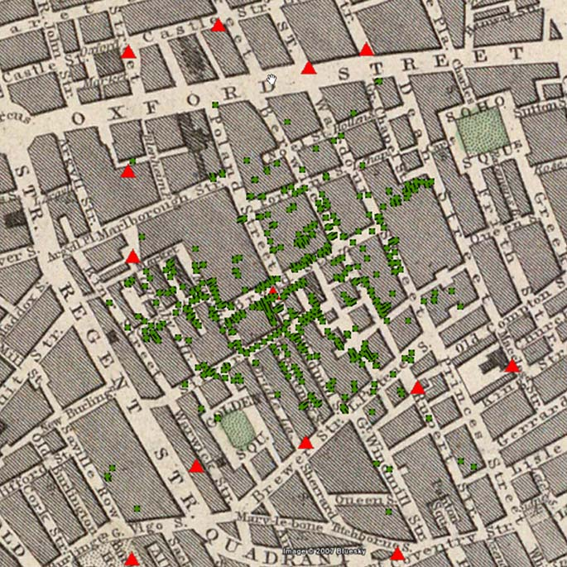
Why are spatial analyses important?
Notes:
Very classic example from 1854
And actually a very important public health related analyses that was conducted here by John Snow
Showing the location of people that suffered from cholera in london as well as the water pumps
Very simple analysis that however easily provides insights that can help to save lives
Very old example, however highlighting the power of spatial information

Slide 7
Why are spatial analyses important?
Group exercise:
Discuss in groups:
Situations in which you benefitted from spatial analyses
Situations in which you could maybe have benefitted from spatial analyses
Main areas where you see potential for spatial analyses in your work
Notes:
Spatial analyses can
10 minutes in breakout rooms
Ideas could be gathered in Miro board
Then share in plenum

Slide 8
Spatial Analyses in QGIS

Slide 9
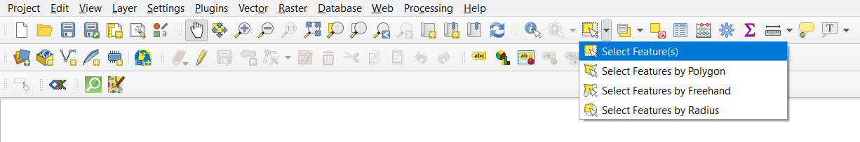
Manual selection of features in QGIS
Click on the respective features directly in the map:
Selection when highlighted in the map and in the attribute table
Select feature by polygon:
Choose „Select feature by polygon“ tool and draw a polygon around the feature of interest
Notes:
Why important?
Easy to detect the specific location of, e.g., an extraordinary feature/area that you detct in the attribute table
Easy to identify specific information about a feature/area if you know the location/see a spatial particularity
No specific exercise, rather sth they can try in hands-on with different data

Slide 10
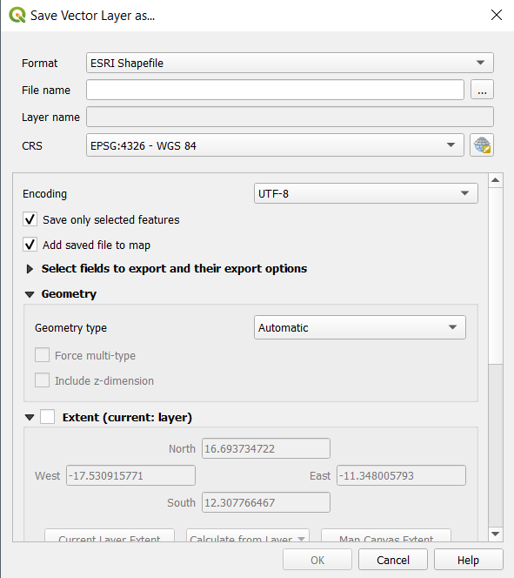
Save selection (same for all selection types)
Save selected features as new layer/ file:
Right click on layer, choose „Export“ and „Save selected features as… “
Choose location where the data should be saved in
Make sure that the mark at „Save only selected features“ is set.

Slide 11
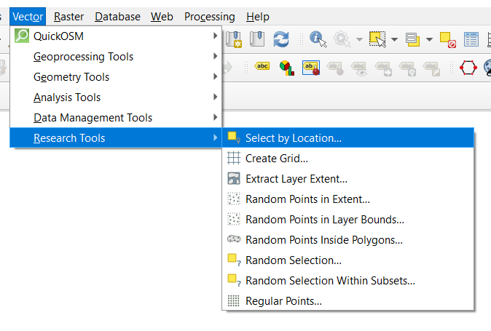
Select by Location Tool
Select all features that meet one or more criteria with regard to a spatial reference

Slide 12
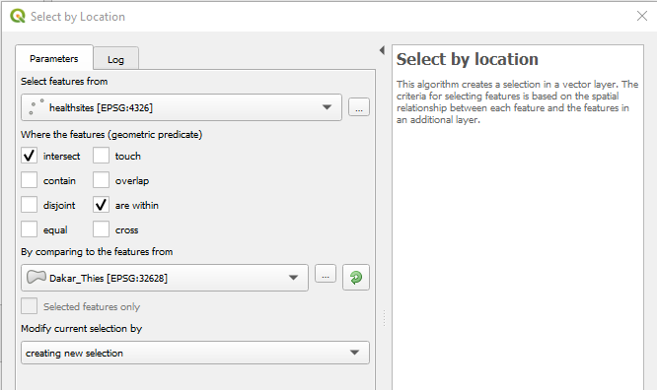
Select by Location Tool
All features that meet one or more criteria with regard to a spatial reference.
Example: Select all features in the Dakar and Thies region.
Step by step:
Select features from input layer (in example select “healthsites”).
Check all geometric predicates that are relevant.
Select second input layer (in example “Dakar_Thies”)
Create new selection.

Slide 13
Select by Location Tool
Combination of spatial queries by choosing in dropdown menu („Modify current selection by“, if multiple selections are conducted in a row)
Adding to current selection (OR)
Example: To identify and select all features that meet only one of the selected criteria
Selecting within current selection (AND)
Example: To identify and select all features that meet all of the selected criteria
Remove from current selection (AND NOT)
Example: To identify and select all features that meet one of the selected criteria but not the other

Slide 14
Non-Spatial Analyses in QGIS

Slide 15
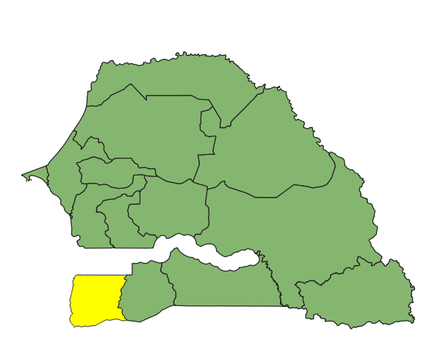
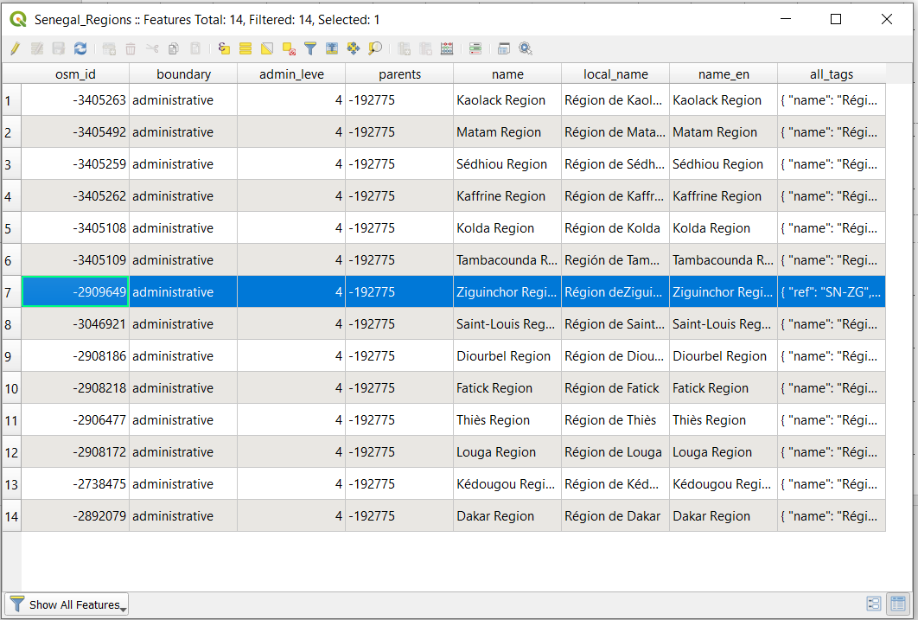
Manual selection
Clicking on the respective features directly in the attribute table
Notes:
No specific exercise, rather sth they can do

Slide 16
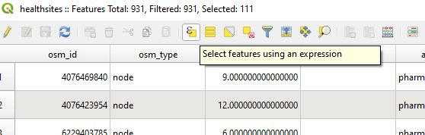
Select feature by expression:
Open the attribute table and open the „Select features using an expression“ window

Slide 17
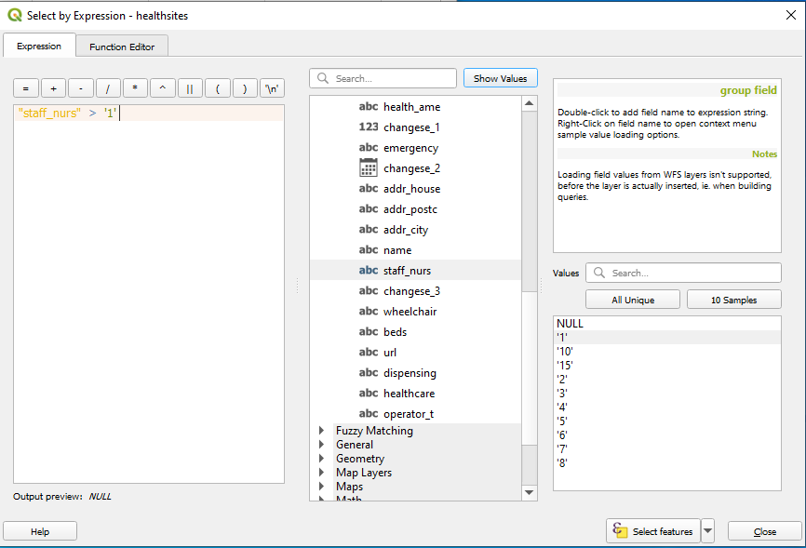
Select feature by expression:
Different kinds of operators to choose from:
Arithmetic operators: >, < , =, !=
Example: Select all health facilities in Senegal which have more than one nurse as staff.
Step by step:
Under “Fields and Values”: Select column name “staff_nurs”
2. Unser “Operators”: Select ”>“
3. Under “Fields and Values”: Click again on selected column name to see all unique values (right bottom, click on “All Unique”)
3. Select the respective unique value (here: ‘1’)
4. Click on “Select features”
Notes:
Careful: Here again whole Senegal healthsites data set
Result: 17 should be selected
Other use cases in relation to vulnerability and resilience: health facility capacities, number of ICUs

Slide 18
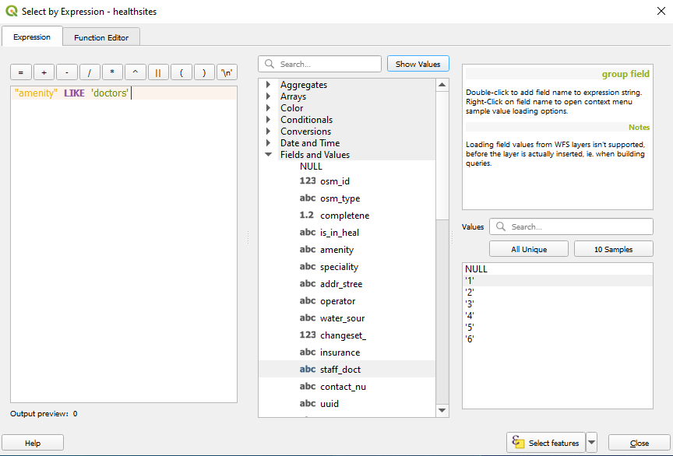
Select feature by expression:
Different kinds of operators to choose from:
String operators:
For example “LIKE“: Select all health facilities that are doctors.
Step by step:
1. Under “Fields and Values”: Select column name “amenity”
2. Unser “Operators”: Select ”LIKE“
3. Under “Fields and Values”: Click again on selected column name to see all unique values (right bottom, click on “All Unique”)
3. Select the respective unique value (here: ‘doctors’)
4. Click on “Select features”
Notes:
229 should be selected
Other examples could be: all health facilities that have an ICU, ventilators etc.
Oftentimes large data sets to deal with, therefore selecting the relevant parameters oftentimes crucial to enable practical work with the data

Slide 19
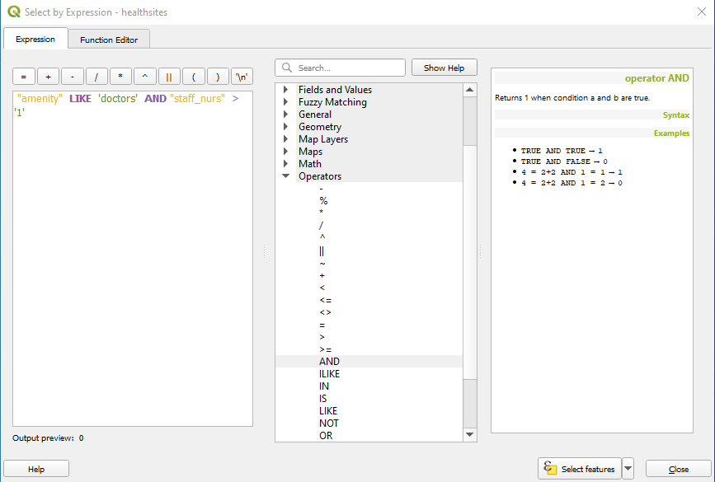
Select feature by expression:
Different kinds of operators to choose from:
Logical operators: “AND“ and “OR“ → Enable to combine different queries/criteria.
Notes:
Result: 16 should be selected
Question: Data quality awareness:
Important: Only a percentage of the facilities include information about the number of staff: always make sure to keep the quality of data in mind when running queries and sharing information based on that!

Slide 20
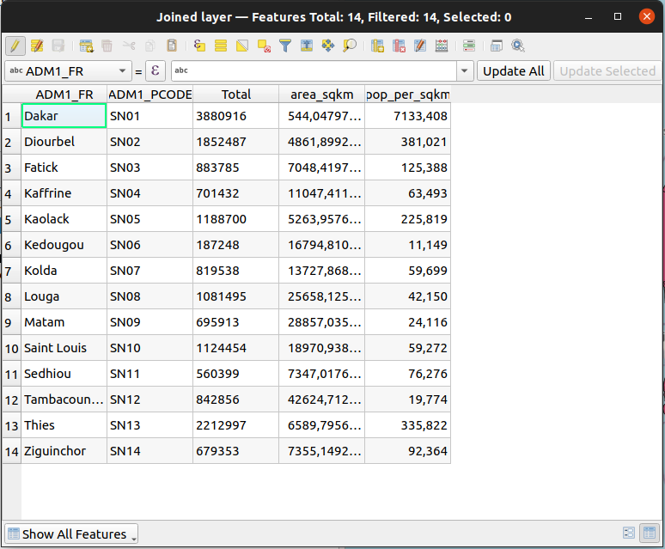
Table Functions
Similar to what you can do in a spreadsheet.
Create Field: add a new attribute and manually insert values
Delete Field: remove attributes that are redundant or attributes you will not work with
Calculate Field: e.g. calculate new attribute population density
Notes:
Result: 16 should be selected
Question: Data quality awareness:
Important: Only a percentage of the facilities include information about the number of staff: always make sure to keep the quality of data in mind when running queries and sharing information based on that!

Slide 21
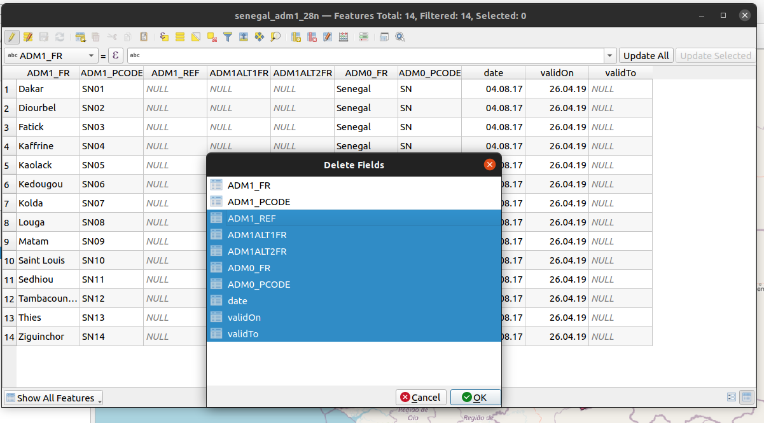
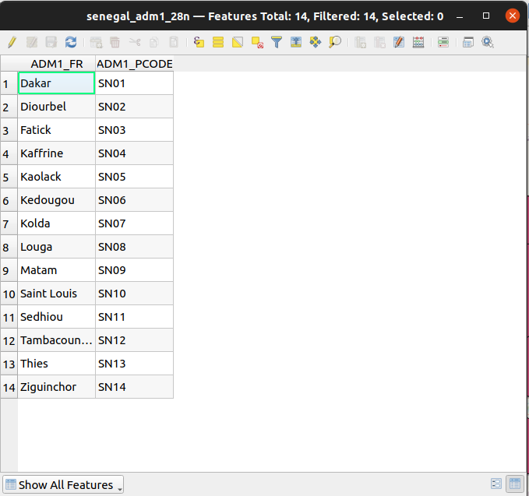
Table Functions - Delete Fields
step 1: start edit mode
step 2: click on delete fields button
step 4: save and stop edit mode
step 3: select fields to remove
Notes:
Result: 16 should be selected
Question: Data quality awareness:
Important: Only a percentage of the facilities include information about the number of staff: always make sure to keep the quality of data in mind when running queries and sharing information based on that!

Slide 22
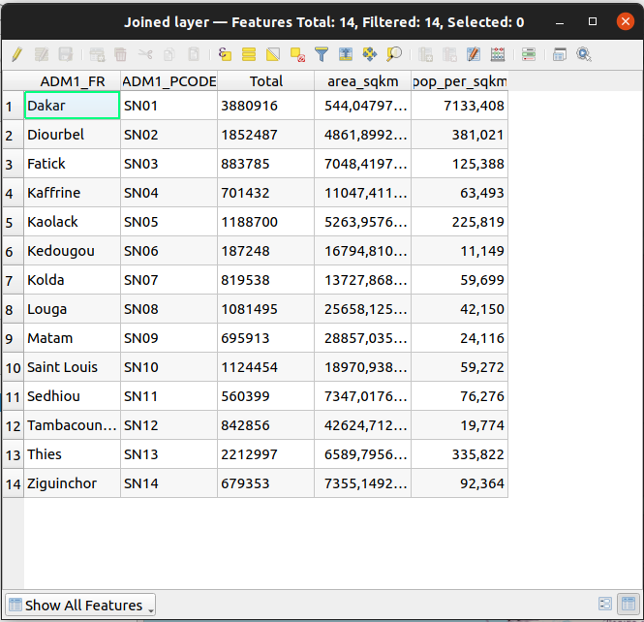
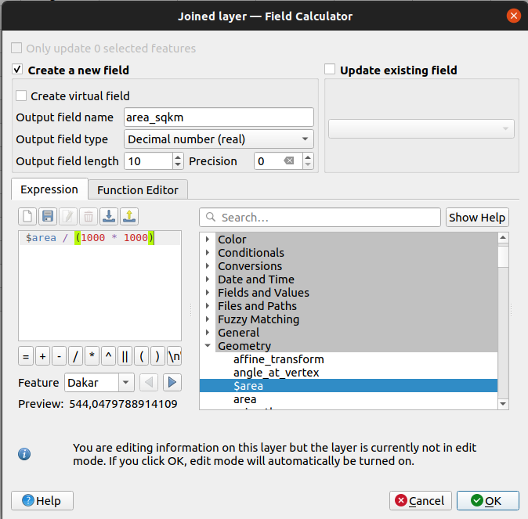
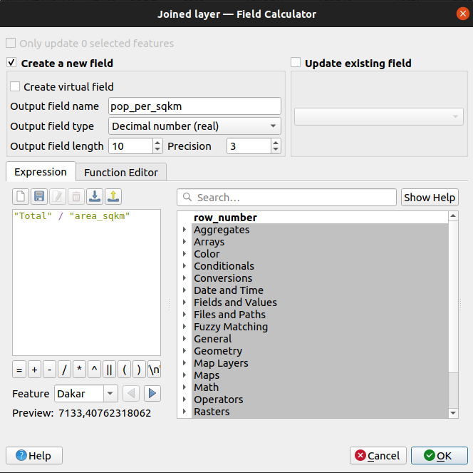
Table Functions - Field Calculator
calculate area in square meters first and then divide by 1,000,000 to get square kilometers
calculate population density as people per square kilometer
Notes:
Result: 16 should be selected
Question: Data quality awareness:
Important: Only a percentage of the facilities include information about the number of staff: always make sure to keep the quality of data in mind when running queries and sharing information based on that!

Slide 23
Hands-On

Slide 24
Geoprocessing Tools (Selection) in QGIS

Slide 25
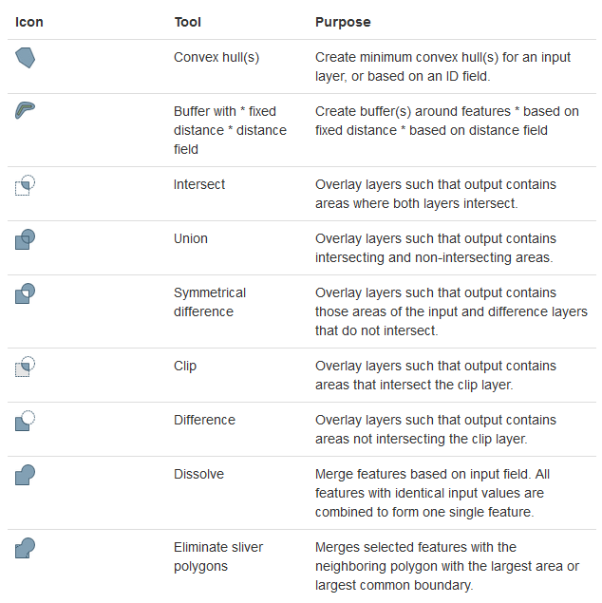
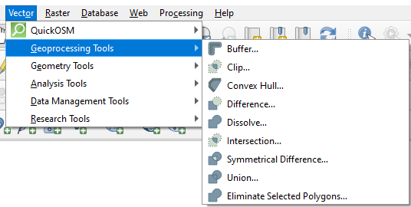
Geoproccesing Tools- Overview
Notes:
All quite straight forward and similar in setup (select input layer(s), parameters and output), therefore focusing on two examples

Slide 26
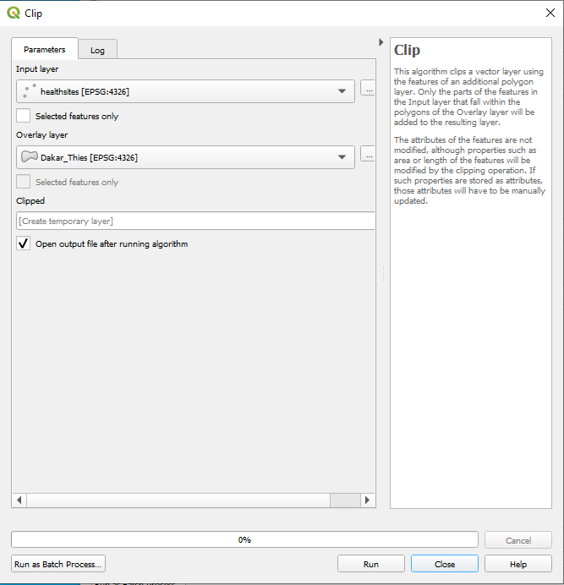
Example: Clip
Creates a selection based on the spatial relationship between each feature in the input layer and the features in an additional layer.
Step by step:
Input Layer: Layer from which the selection is clipped
Overlay Layer: Area of interest that the input layer will be clipped to
Notes:
Useful if you have a data set that covers more than your area of interest
Covered in main exercise (Exercise_Day_3), but could also do for example same as in “Select by location” tool: Select all healthsites within Dakar_Thies

Slide 27
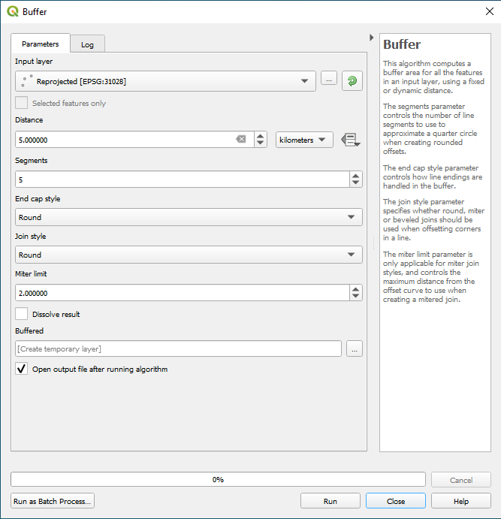
Example: Buffer
Computes (a) buffer area(s) for all the features in an input layer, using a specified distance.
Step by step:
Input Layer: Layer around which features the buffer(s) are to be created
Distance: Choose a value and unit (make sure that your input data is projected)
Segments: Add value
Mark „Dissolve result“ to automatically dissolve the buffer outputs
If individual buffers are needed, leave blank
Notes:
Example in main exercise
If also time here, could create a buffer around all healthsites in the Dakar_Thies region

Slide 28
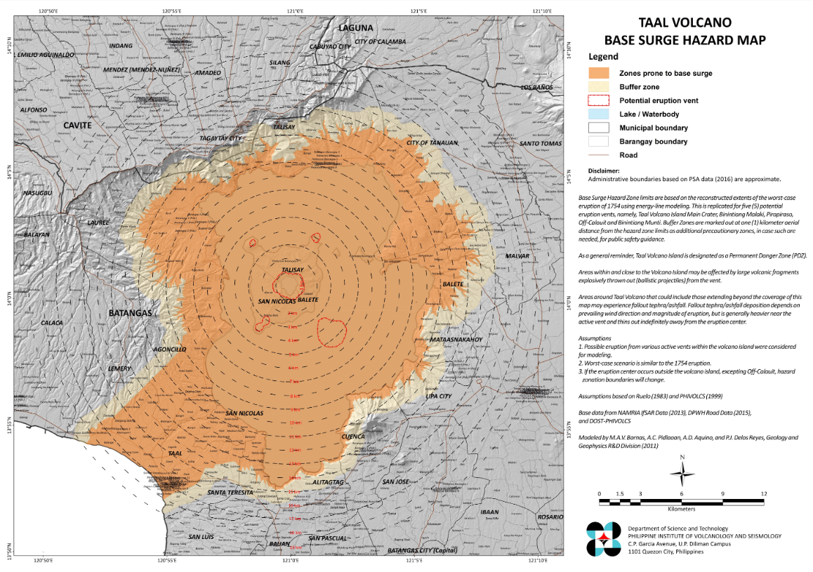
Examples for buffer usage
Philippine Institute of Volcanology and Seismology
https://www.phivolcs.dost.gov.ph/vault/1BaseSurge_Layout-Jan2020_A0_v5.jpg

Slide 29
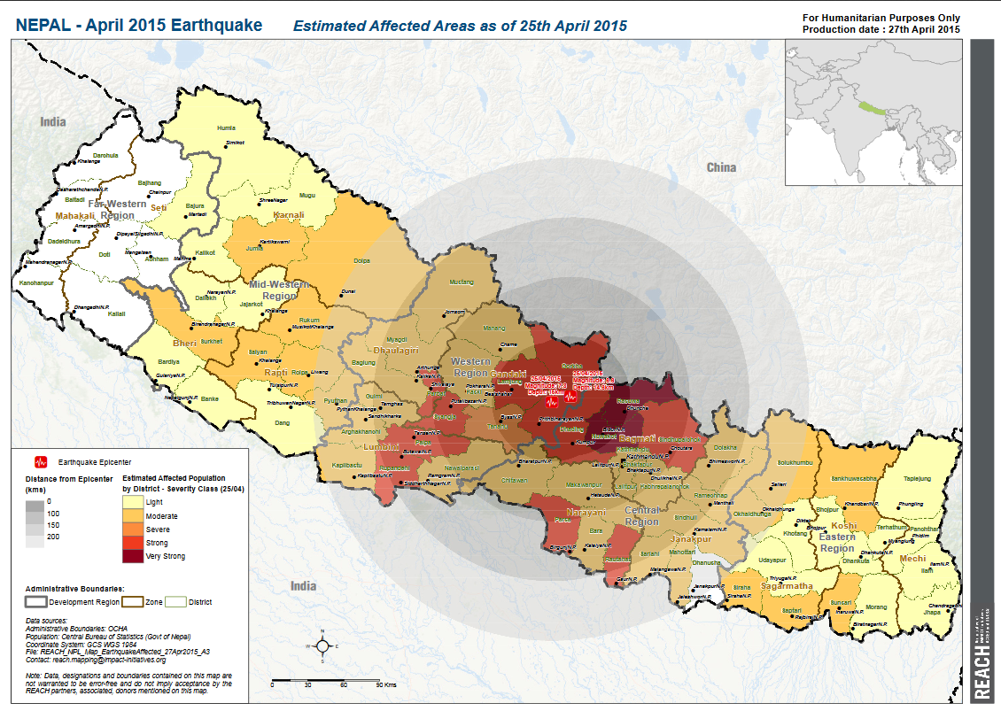
Examples for buffer usage
https://reliefweb.int/sites/reliefweb.int/files/resources/reach_npl_map_earthquakeaffected_27apr2015_a3.pdf

Slide 30
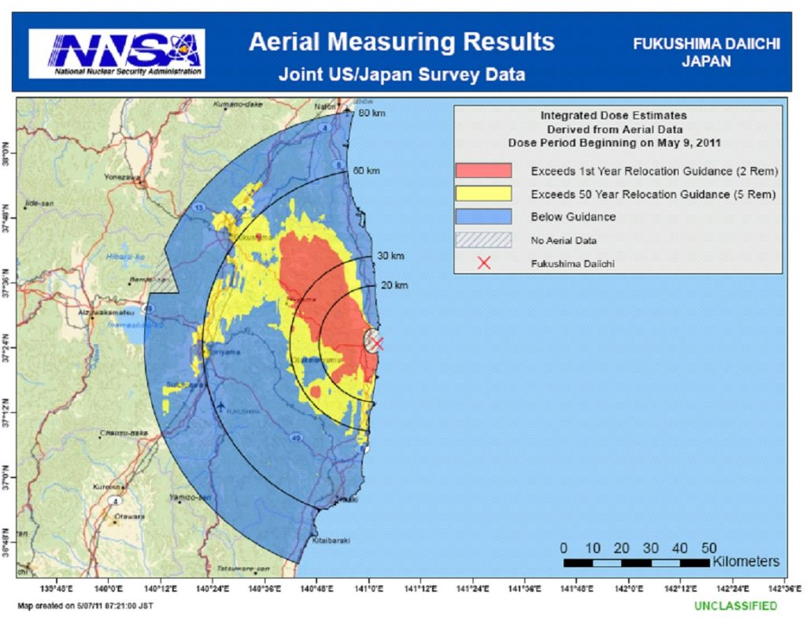
Examples for buffer usage
https://www.emsics.com/five-years-fukushima-incident-management-considerations/

Slide 31
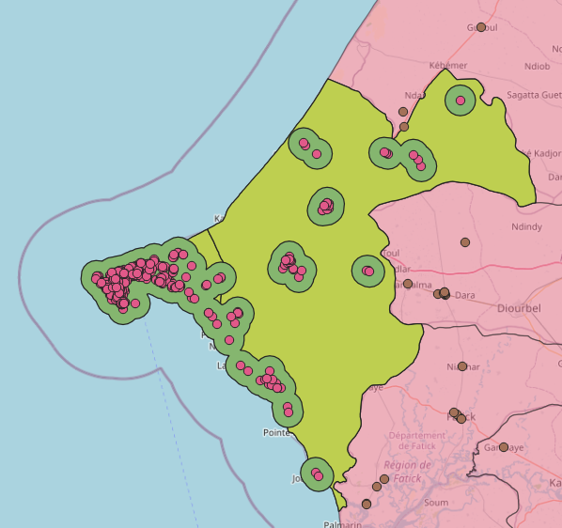
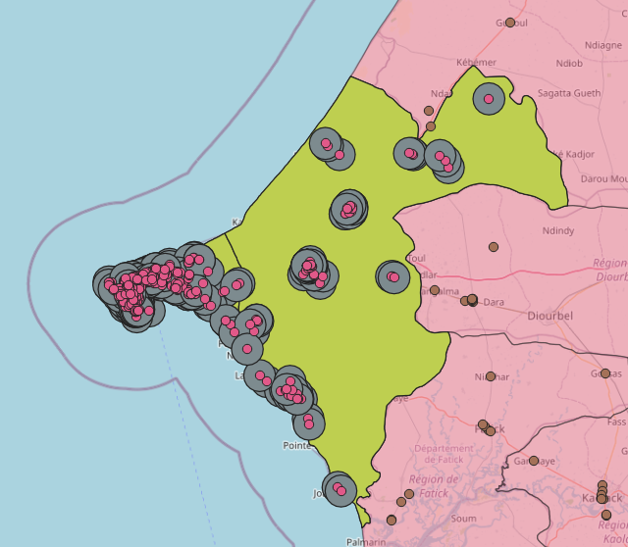
Buffer: with and without “dissolve”
With “dissolve results“ Without „dissolve results“

Slide 32
(Non) Spatial Joins in QGIS

Slide 33
Non-Spatial Joins
Choose “Join Attributes by Field Value” Tool (use search tool):
Adds attributes of a non-spatial table to the layer
Enables join using a field/column that is present in both data sets
Notes:
Example in Exercise_3 then!

Slide 34
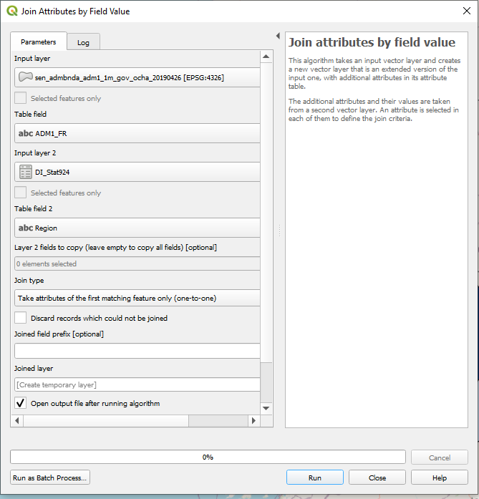
Non-Spatial Joins
Step by step:
Input layer: Vector layer
Table field: Field/ column that exists in both data sets (name of column in vector layer)
Input layer 2: Text/csv/xls data
Table field 2: Field/ column that exists in both data sets (name of column in text/csv/xls)
Join type: Select „Take attributes of the first matching feature only (one-to-one)“.
Define output layer name and destination or leave at temporary layer

Slide 35
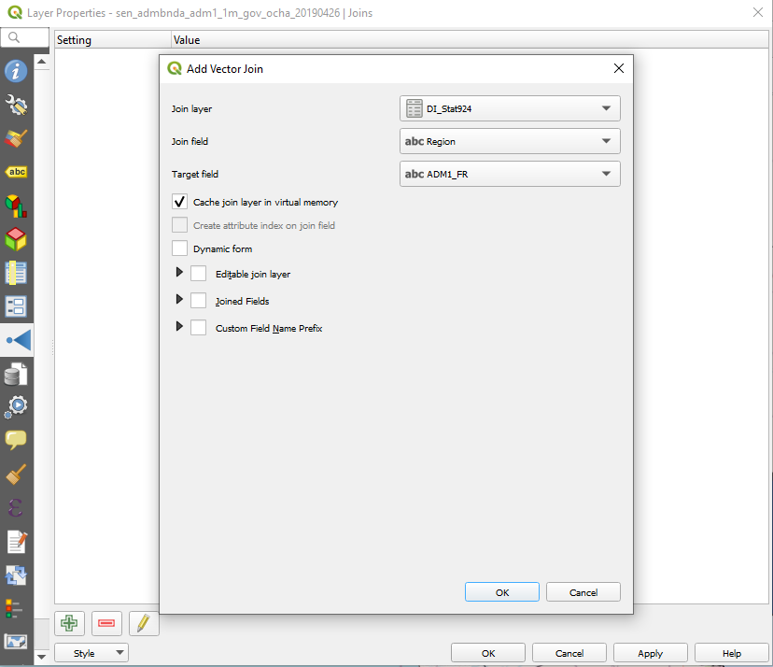
Non-Spatial Joins
Hint: If a table join does not work via the “Join Attributes by Field Value” tool,
a join can also be performed via the layer properties (right-click, Properties) under the Join tab.

Slide 36
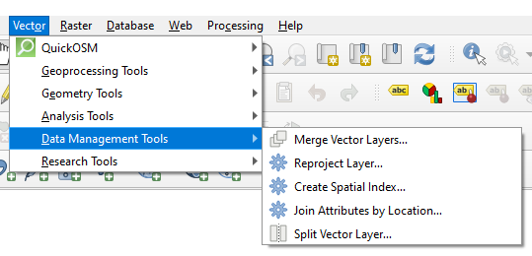
Spatial Joins
Choose “Join Attributes by Location” Tool:
Adds additional attributes of the join layer to the input layer based on the spatial relationship
Input Layer: Dataset you want to enrich
Join layer: Dataset with additional information/attributes
(you can specify which fields of the
join layer should be added)
Notes:
No specific example here

Slide 37
Your turn ☺
Day_3_Exercise_Senegal: https://gitlab.com/Alec-SE/gis-in-anticipatory-humanitarian-action/-/tree/main/Exercise_4

